Slide 1
CSI3344 Distributed Systems
Lecture 11
Introduction to CORBA and DCOM
Contents
  11.1 Introduction to CORBA
  11.2 Introduction to DCOM
  11.3 Comparison of CORBA and DCOM
CSI3344

Slide 2
Objectives
Be aware of fundamentals of CORBA;
Be aware of fundamentals of DCOM;
Key services offered by CORBA and DCOM
CSI3344

Slide 3
Introduction
A set of complete tools should be provided for implementing, managing and improving performance of a distributed system.
Middleware technology tries to provide these tools in the form of a ‘platform’ for developers to construct and implement distributed applications.
CORBA and DCOM are 2 popular middleware systems.
There are a number of services common to many middleware systems:
    communication,
    Process & naming services,
    synchronization,
    consistency,
    fault tolerance,
    Security, etc.
CSI3344
Notes:
CORBA: a standard defined by the Object Management Group (OMG) that enables software components written in multiple computer languages and running on multiple computers to work together, i.e. it supports multiple platforms.
Middleware Examples:
Sun RPC (Remote Procedure Calls)
OMG CORBA (Common Object Request Broker Architecture)
Microsoft D-COM (Distributed Components Object Model)
Sun Java RMI
Some modern Middleware:
Manjrasoft Aneka– for Cloud computing
IBM WebSphere
Microsoft .NET
Sun J2EE, SUN Microsystems (JavaBeans Component System)
Google AppEngine
Etc.
CORBA is a mechanism in software for normalizing the method-call semantics between application objects that reside either in the same address space (application) or remote address space (same host, or remote host on a network). Version 1.0 was released in October 1991. CORBA uses an interface definition language (IDL) to specify the interfaces that objects will present to the outside world. CORBA then specifies a mapping from IDL to a specific implementation language like C++ or Java. Standard mappings exist for Ada, C, C++, Lisp, Ruby, Smalltalk, Java, COBOL, PL/I and Python. There are also non-standard mappings for Perl, Visual Basic, Erlang, and Tcl implemented by object request brokers (ORBs) written for those languages.
DCOM - Distributed Component Object Model, a Microsoft technology for software distributed across several networked computers to communicate with each other.
Some other interface-technology (or meddleware) are: JavaBean, Microsoft .Net (framework), etc.

Slide 4
11.1 Introduction to CORBA (1)
Fundamentals of CORBA
  CORBA – Common Object Request Broker Architecture, initiated by OMG in the early 1990s.
  OMG – Object Management Group
    - with 800+ members, primarily from industry.
  CORBA global architecture is specified by OMG reference model:
      CORBA 1 - Interface Definition Language (IDL);
      CORBA 2 – Interoperability;
      CORBA 3 – Internet integration, service control, and
      component architecture.
CSI3344
Notes:
Acronym:
OMG initiate many industry standards, such as OQL, the object-oriented programming version SQL.

Slide 5
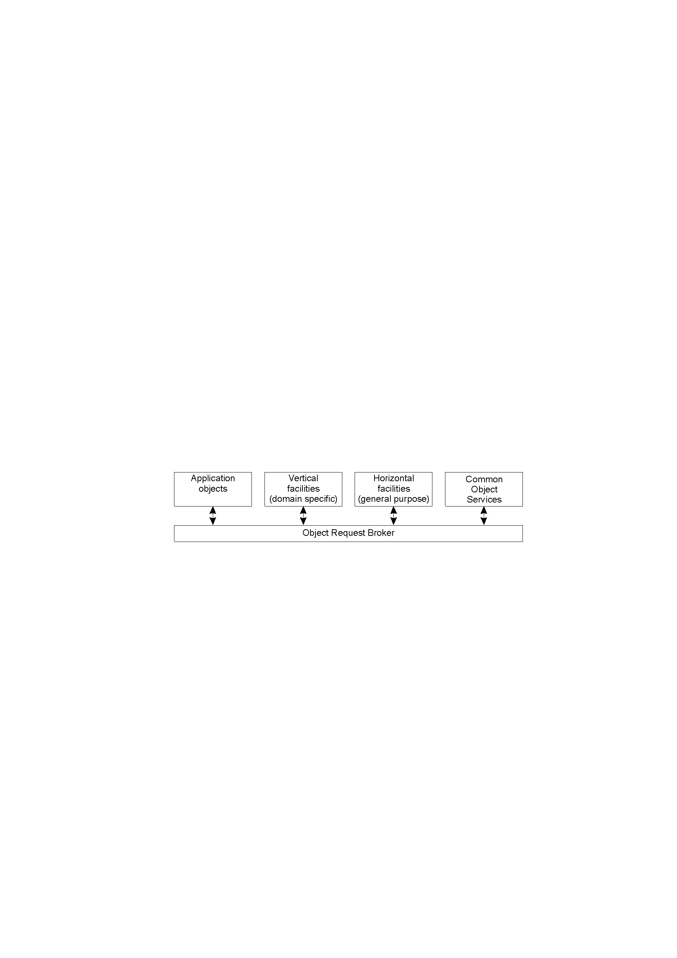
11.1 Introduction to CORBA (2)
CORBA global architecture
CSI3344

Slide 6
11.1 Introduction to CORBA (3)
CORBA global architecture
  ORB – Object Request Broker
    The ORB forms the core of any CORBA system. It is responsible for enabling communication between objects and their clients.
    The ORB is implemented as libraries.
  Horizontal facilities
    Containing general-purpose high-level services that are independent of application domain, such as user interfaces, system management, and so on.
  Vertical facilities
    Consisting of high-level services that are offered to a specific application domain, such as banking, e-commerce, etc.
CSI3344

Slide 7
11.1 Introduction to CORBA (4)
General Organization of a CORBA System
  Interaction
client
implementation
interface
server
repository
repository
object
skeleton
adapter
client
proxy
ORB
Request
ORB
Servant
program
for A
core
core
A
Reply
or dynamic invocation
or dynamic skeleton
CSI3344

Slide 8
11.1 Introduction to CORBA (5)
What is an ORB? (1)
It locates the remote object on the network, communicates the request to the object, waits for the results and when available communicates those results back to the client.
The ORB implements location transparency. Exactly the same request mechanism is used by the client and the CORBA object regardless of where the object is located.
The ORB implements programming language independence for the request.
  The client issuing the request can be written in a different programming language from the implementation of the CORBA object.
  The ORB does the necessary translation between programming languages.
CSI3344

Slide 9
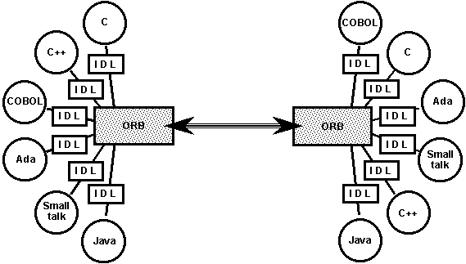
11.1 Introduction to CORBA (6)
What is an ORB? (2)
Language bindings are defined for all popular programming languages. There are ORBs available for many combinations of OS and development environments e.g. an ORB for Java on Unix, or for C++ on Windows NT.
CSI3344

Slide 10
11.1 Introduction to CORBA (7)
Why use CORBA?
CORBA provides a high degree of interoperability that tries to ensure that distributed objects built on top of different CORBA compliant products can communicate.
CORBA supports many existing languages, and supports the mixing of these languages within a single distributed application.
CORBA is an industry standard which provides developers with a degree of portability between implementations.
CORBA compliant applications can be used by all companies with CORBA compliant projects or systems (although, sometimes, a little tweaking is required).
CSI3344

Slide 11
11.1 Introduction to CORBA (8)
How to develop CORBA compliant application (simplified procedure):
Write your object-oriented program as usual;
Get it working all on one computer;
Write a CORBA wrapper for the object you'd like to remote;
Replace references to the local object with references to the remote object.
CSI3344
Notes:
Assuming for both the client and the server, the interface to the ORB is static, not dynamic, i.e. that is it is based on an IDL specification

Slide 12
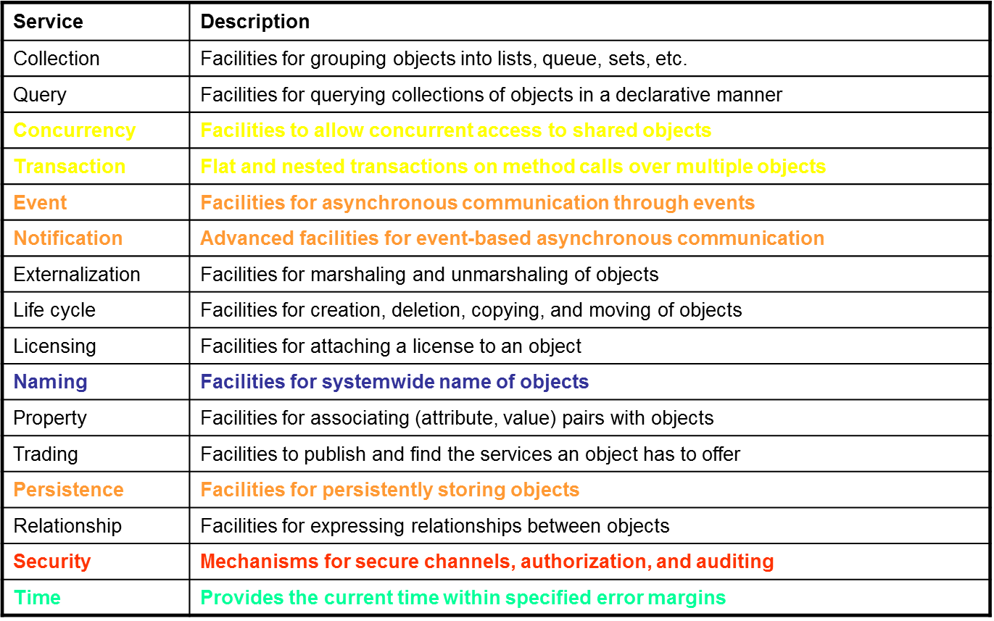
11.1 Introduction to CORBA (9)
CORBA Services
CSI3344
Notes:
Collections: include arrays, list (linked lists), sets (hashset & TreeSets) – almost all objects

Slide 13
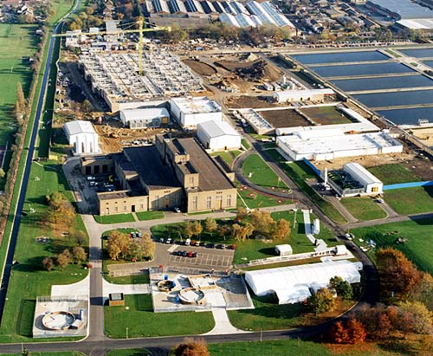
11.1 Introduction to CORBA (10)
Example 1 - Thames Water
Thames Water is one of the world's largest water and wastewater companies, serving 12 million customers in London and across the Thames Valley. World-wide the company serves over 21 million people.
They created a component based
system using CORBA that allows
the 1000 plus system users to
communicate from the field and office.
This system allows remote users
access to data that is necessary to
complete the required tasks in the field.
CSI3344

Slide 14

11.1 Introduction to CORBA (11)
Example 2 - Bank of America
Bank of America built an object-based customer service system that allows credit-card holders to access account information over the Internet.
The system is based on CORBA, a network-independent standard for deploying distributed objects. The project marks Bank of America's second major deployment of CORBA. The company is already using an object-based customer relations management system called Vista.
CSI3344
Notes:
Bank of America
California Street
San Francisco, CA
http://www.bankamerica.com
Tools Used:
Hitachi's OpenTP-Broker object transaction manager, CORBA®, Inprise's Visibroker™
Description:
Bank of America built an object-based customer service system that allows credit-card holders to access account information over the Internet. The system is based on CORBA, a network-independent standard for deploying distributed objects. The project marks Bank of America's second major deployment of CORBA. The company is already using an object-based customer relations management system called Vista.
The later system, Concorde CreditCard OnLine, gave the bank's credit-card customers access to their accounts over the Internet and lets them perform the functions normally available via a customer service line, such as checking balance and payments.
CORBA was chosen because it was felt no other architecture delivers the kind of scalability necessary for handling a large volume of users and data.

Slide 15
11.2 Introduction to DCOM (1)
Fundamentals of DCOM
  COM – Microsoft's Component Object Model, firstly introduced into Windows 95.
  DCOM – Distributed COM. DCOM offers primarily access transparency. To a programmer, COM and DCOM are the same.
  No CORBA-like committee governing architectural and technical regulations exists, similar things can be done in many different ways; on the other hand, coexistence of different solutions is sometimes impossible.
CSI3344
Notes:
OLE - Object Linking and Embedding
ActiveX – a software framework created by Microsoft which adapts its earlier COM and OLE technologies for content downloaded from networks, particularly from WWW. Introduced in 1996, commonly used in MS OS.

Slide 16
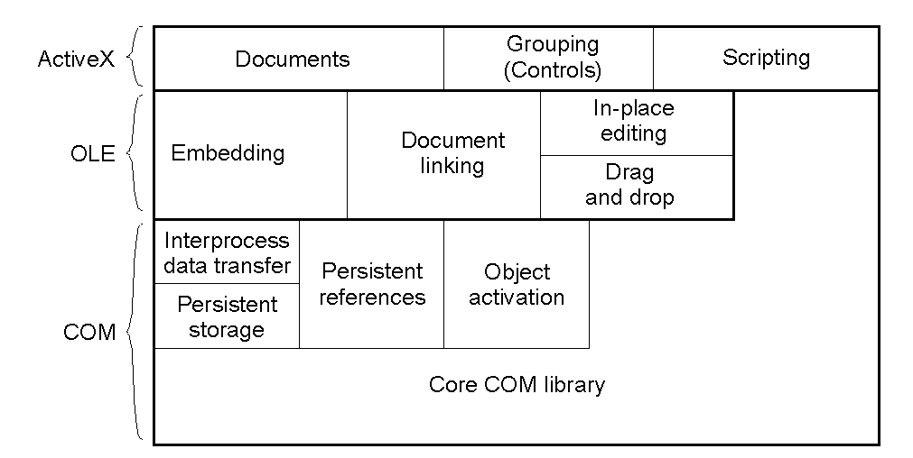
11.2 Introduction to DCOM (2)
General organization of ActiveX, OLE, and COM
CSI3344
Notes:
OLE - Object Linking and Embedding
ActiveX – a software framework created by Microsoft which adapts its earlier COM and OLE technologies for content downloaded from networks, particularly from WWW. Introduced in 1996, commonly used in MS OS.

Slide 17
11.2 Introduction to DCOM (3)
General organization of ActiveX, OLE, and COM
  COM
    COM is an OS-like system to support the development of components that can be dynamically activated and that can interact with each other (text, image, table, etc).
  OLE – Object Linking and Embedding
    OLE offers support for connectivity of the various components.
  ActiveX
    Functionally similar to OLE, ActiveX provides more powerful and flexible capabilities for supporting activities of components in different processes.
CSI3344

Slide 18
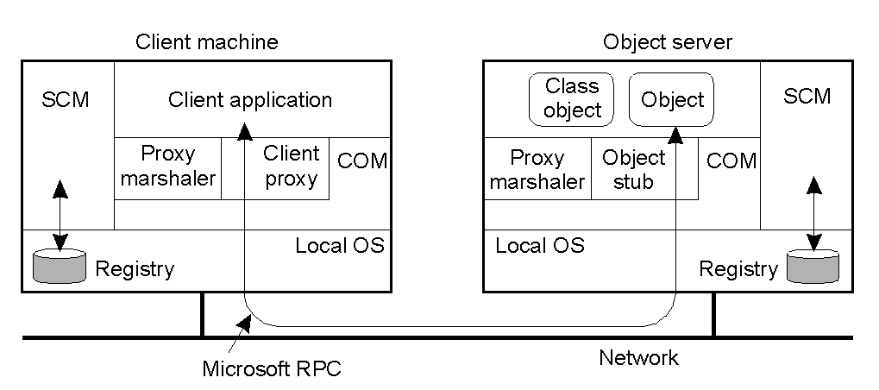
11.2 Introduction to DCOM (4)
General Organization of a DCOM System
CSI3344
Notes:
SCM – Service control manager

Slide 19
11.2 Introduction to DCOM (5)
General Organization of a DCOM System
  Type Library and Registry
  DCOM interface repository is called type library. A list of all type libraries is kept in Registry, which directs an incoming invocation to the requested type library (interface), and then the associated object is executed.
  SCM – Service Control Manager
  SCM is a process responsible for activating remote objects, similar to the implementation repository in CORBA. To execute an object on a remote host, the client contacts the host’s SCM, which looks into its own local registry to find the file and then start it.
  Registry + COM ⇒ ORB in CORBA
CSI3344
Notes:
ActiveX is a framework for defining reusable software components in a programming language independent way. Software applications can then be composed from one or more of these components in order to provide their functionality.
It was introduced in 1996 by Microsoft as a development of its Component Object Model (COM) and Object Linking and Embedding (OLE) technologies and is commonly used in its Windows operating system, although the technology itself is not tied to it.
Many Microsoft Windows applications — including many of those from Microsoft itself, such as Internet Explorer, Microsoft Office, Microsoft Visual Studio, and Windows Media Player — use ActiveX controls to build their feature-set and also encapsulate their own functionality as ActiveX controls which can then be embedded into other applications. Internet Explorer also allows embedding ActiveX controls onto web pages.

Slide 20
11.2 Introduction to DCOM (6)
DCOM Services
CORBA Service | DCOM/COM+ Service | Windows 2000 Service
Collection | ActiveX Data Objects | -
Query | None | -
Concurrency | Thread concurrency | -
Transaction | COM+ Automatic Transactions | Distributed Transaction Coordinator
Event | COM+ Events | -
Notification | COM+ Events | -
Externalization | Marshaling utilities | -
Life cycle | Class factories, JIT activation | -
Licensing | Special class factories | -
Naming | Monikers | Active Directory
Property | None | Active Directory
Trading | None | Active Directory
Persistence | Structured storage | Database access
Relationship | None | Database access
Security | Authorization | SSL, Kerberos
Time | None | None

Slide 21
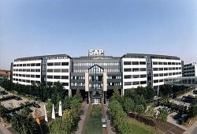
11.2 Introduction to DCOM (7)
SAP Business Framework
For a long time, the integration of SAP components delivered by different vendors required specialized knowledge in various, widely differing environments and often was an expensive, manual integration process.
Now SAP ships technologies like the DCOM
Component Connector with the Business
Framework.
The DCOM Component Connector, the result of a
joint effort of SAP and Microsoft, allows the
automatic, seamless integration of products on the
basis of Microsoft's DCOM.
CSI3344
Notes:
SAP AG, a global software company headquartered in Walldorf, Germany or its various products.

Slide 22
11.3 Comparison of CORBA and DCOM (1)
Issue | CORBA | DCOM
Design goals | Interoperability | Functionality
Object model | Remote objects | Remote objects
Services | Many of its own | From environment
Interfaces | IDL based | Binary
Sync. communication | Yes | Yes
Async. communication | Yes | Yes
Callbacks | Yes | Yes
Events | Yes | Yes
Messaging | Yes | Yes
Object server | Flexible | Hard-coded
Directory service | Yes | Yes
Trading service | Yes | No
CSI3344

Slide 23
11.3 Comparison of CORBA and DCOM (2)
Issue | CORBA | DCOM
Naming service | Yes | Yes
Location service | No | No
Object reference | Object's location | Interface pointer
Synchronization | Transactions | Transactions
Replication support | Separate server | None
Transactions | Yes | Yes
Fault tolerance | By replication | By transactions
Recovery support | Yes | Yes
Security | Various mechanisms | Various mechanisms
CSI3344

Slide 24
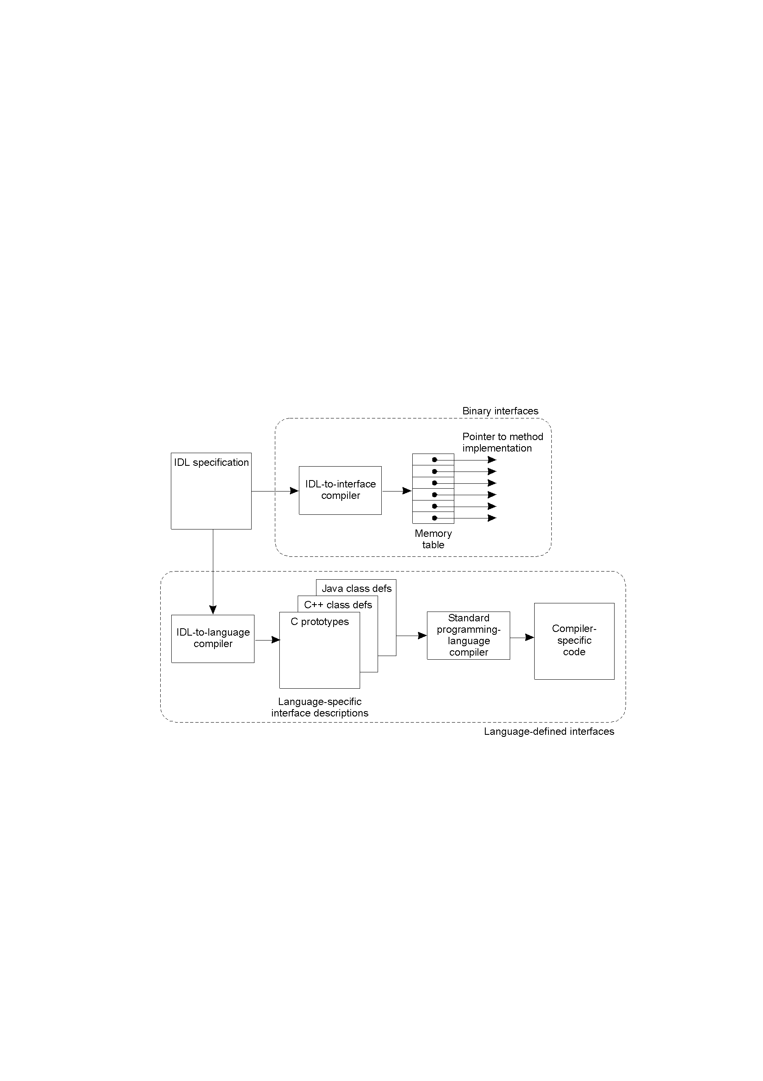
11.3 Comparison of CORBA and DCOM (2)
The difference between language-defined and binary interfaces
CSI3344

Slide 25
11.3 Comparison of CORBA and DCOM (4)
Language-defined and binary interfaces
  1. CORBA follows a language-based interface approach by providing a standard IDL in which specifications are mapped to various languages.
  Good/Bad:
    Independent of compilers – interoperability at the level of programming languages
CSI3344

Slide 26
11.3 Comparison of CORBA and DCOM (5)
Language-defined and binary interfaces
  2. DCOM follows binary interface approach, in which interfaces to objects are defined independent of programming languages.
  Good:
  achieve maximum portability and interoperability.
  Bad:
  clients may need to learn the Microsoft IDL.
CSI3344

Slide 27
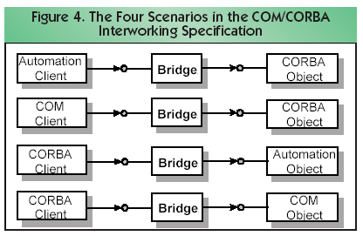
10.2 Secure Channels – Authentication (3)
There is often a need for ‘internetworking’ between CORBA and DCOM.
This is generally done by providing a bridge between DCOM and
CORBA. Many vendors provide this functionality to expand their
market.
There are four possible
scenarios usually
provided for as can be
seen in the diagram.
CSI3344
Notes:
1: Alice sends ID to Bob
2: Bob sends challenge RB (i.e. a random number from Bob) to Alice
3: Alice encrypts RB with shared key KA,B. Now Bob knows he's talking to Alice
4: Alice send challenge RA to Bob
5: Bob encrypts RA with KA,B. Now Alice knows she's talking to Bob
Note: We can improve the protocol by combining steps 1&4, and 2&3. This costs only the correctness.

Slide 28
Major Points
General Organization of a CORBA System
General Organization of a DCOM System
The difference between language-defined and binary interfaces
Reading Guide
  DSPP: 10.1.1, 10.2.1, 10.3.1
CSI3344

